Slide 1
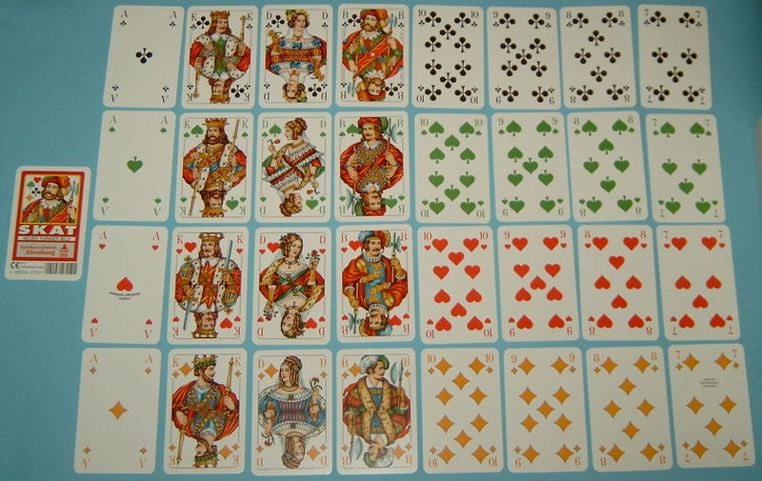
How can we sort a deck of cards?
wikipedia

Slide 2
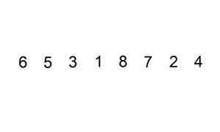
InsertionSort
Video: http://www.youtube.com/watch?v=cFoLbjGUKWs
What is the algorithm?
wikipedia

Slide 3
InsertionSort – Specification
First let’s make sure we know what we want to do:
The specification of the algorithm
AKA the problem we are trying to solve
Input: sequence of n numbers
A=(a₁, … a_{n})
Output: a permutation (reordering) of the input
(a’₁, … a’_{n})
Such that
a’₁ ≤ a’₂ ≤ … ≤ a’_{n}

Slide 4
InsertionSort
Algorithm (in English)
Start from 1st element of the array (optimisation: start from 2nd)
Shift element back until you find a smaller element – maintain the array from 0 to (current position) sorted.
Continue to next element
Repeat (2) and (3) until the end of the array

Slide 5
InsertionSort
Algorithm (in pseudocode)
for (j = 1; j<A.length; j++) {
//shift A[j] into the sorted A[0..j-1]
i=j-1
while i>=0 and A[i]>A[i+1] {
swap A[i], A[i+1]
i=i-1
}}
return A

Slide 6
InsertionSort
Algorithm (in Java)
left as an exercise.

Slide 7
We are skipping the first number A[0]
A.length == n
for (j = 1; j<A.length; j++) {
//shift A[j] into the sorted A[0..j-1]
i=j-1
while i>=0 and A[i]>A[i+1] {
swap A[i], A[i+1]
i=i-1
}}
return A

Slide 8
for (j = 1; j<A.length; j++) {
//shift A[j] into the sorted A[0..j-1]
i=j-1
while i>=0 and A[i]>A[i+1] {
swap A[i], A[i+1]
i=i-1
}}
return A
How to calculate runtime performance?

Slide 9
Calculating Approximate Performance
Assume basic operations cost 1
Then, choose one:
Count all operations (if uncertain, it’s the safer choice)
Count only some operations (which ones?)
Then, keep only highest-order terms (~ notation)

Slide 10
cost no of times
for (j = 1; j<A.length; j++) { 1
//shift A[j] into the sorted A[0..j-1]
i=j-1 1
while i>=0 and A[i]>A[i+1] { 1
swap A[i], A[i+1] 1
i=i-1 1
}}
return A 1

Slide 11
Method of Calculations
Assume basic operations cost 1
Then, choose one:
Count all operations (if uncertain, it’s the safer choice)
Count only some operations (which ones?)
We will count only array comparisons and array swaps
It is equivalent to counting array accesses
Then, keep only highest-order terms (~ notation)

Slide 12
cost no of times
for (j = 1; j<A.length; j++) {
//shift A[j] into the sorted A[0..j-1]
i=j-1
while i>=0 and A[i]>A[i+1] { 1
swap A[i], A[i+1] 1
i=i-1
}}
return A

Slide 13
cost no of times
for (j = 1; j<A.length; j++) {
//shift A[j] into the sorted A[0..j-1]
i=j-1
while i>=0 and A[i]>A[i+1] { 1
swap A[i], A[i+1] 1
i=i-1
}}
return A
The input is A, an array of size N.
Besides the size N, is the “no of times” dependent of the actual ints in A?

Slide 14
Best Case
cost no of times
for (j = 1; j<A.length; j++) {
//shift A[j] into the sorted A[0..j-1]
i=j-1
while i>=0 and A[i]>A[i+1] { 1
swap A[i], A[i+1] 1
i=i-1
}}
return A
In the best case the array is already sorted.

Slide 15
Best Case
cost no of times
for (j = 1; j<A.length; j++) {
//shift A[j] into the sorted A[0..j-1]
i=j-1
while i>=0 and A[i]>A[i+1] { 1 (1+1+…+1)_{n-1 times}
swap A[i], A[i+1] 1 0
i=i-1
}}
return A
In the best case the array is already sorted.
The time (as a function of the input size n):
T(n) = n - 1

Slide 16
Worst Case
cost no of times
for (j = 1; j<A.length; j++) {
//shift A[j] into the sorted A[0..j-1]
i=j-1
while i>=0 and A[i]>A[i+1] { 1
swap A[i], A[i+1] 1
i=i-1
}}
return A

Slide 17
Worst Case
cost no of times
for (j = 1; j<A.length; j++) {
//shift A[j] into the sorted A[0..j-1]
i=j-1
while i>=0 and A[i]>A[i+1] { 1
swap A[i], A[i+1] 1
i=i-1
}}
return A
In the worst case the array is in reverse sorted order.

Slide 18
Worst Case
cost no of times
for (j = 1; j<A.length; j++) {
//shift A[j] into the sorted A[0..j-1]
i=j-1
while i>=0 and A[i]>A[i+1] { 1 2+…+n
swap A[i], A[i+1] 1 1+…+(n-1)
i=i-1
}}
return A
In the worst case the array is in reverse sorted order.
T(n) = Σ_{i=2..n}(i) + Σ_{i=1..n-1}(i) = Σ_{i=1..n}(i) - 1 + Σ_{i=1..n-1}(i)
= (n(n+1)/2 - 1) + 2n(n-1)/2
~ (5/2)n²

Slide 19
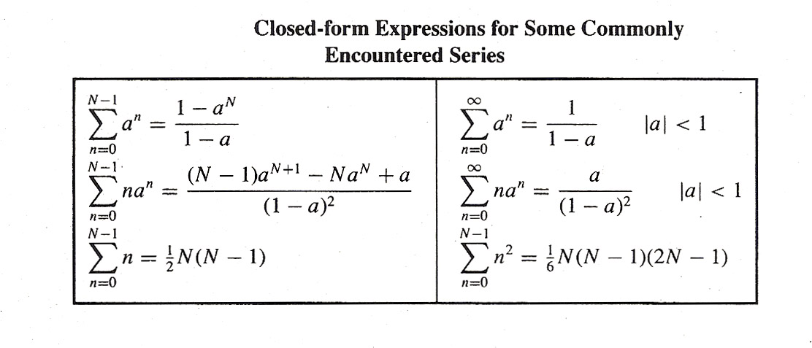

Slide 20
Average Case
cost no of times
for (j = 1; j<A.length; j++) {
//shift A[j] into the sorted A[0..j-1]
i=j-1
while i>=0 and A[i]>A[i+1] { 1 (2+…+n)/2
swap A[i], A[i+1] 1 (1+…+(n-1))/2
i=i-1
}}
return A
In the worst case the array is in reverse sorted order.
T(n) = …(same calculations)… ~ (5/4)n²

Slide 21
InsertionSort – three types of analyses
With best case input of size n:
T(n) ~ 3 n
with the worst case input of size n:
T(n) ~ (5/2)n²
with average input of size n:
T(n) ~ (5/4)n²

Slide 22
InsertionSort – three types of analyses
With best case input of size n:
T(n) ~ 3 n
Order of growth: n (linear)
with the worst case input of size n:
T(n) ~ (5/2)n²
Order of growth: n² (quadratic)
with average input of size n:
T(n) ~ (3/4)n²
Order of growth: n²

Slide 23
InsertionSort
Which case analysis would you pick?
With best case input of size n:
T(n) ~ 3 n
Order of growth: n (linear)
with the worst case input of size n:
T(n) ~ (5/2)n²
Order of growth: n² (quadratic)
with average input of size n:
T(n) ~ (3/4)n²
Order of growth: n²

Slide 24
InsertionSort
We will focus on Worst Case:
“InsertionSort is quadratic”
=
“The worst case running time of InsertionSort is quadratic”
=
”InsertionSort with the worst case input of size N runs in Θ(N²) time”
With best case input of size n:
T(n) ~ 3 n
Order of growth: n (linear)
with the worst case input of size n:
T(n) ~ (5/2)n²
Order of growth: n² (quadratic)
with average input of size n:
T(n) ~ (3/4)n²
Order of growth: n²

Slide 25
InsertionSort
Sometimes we will talk about on Average Case:
”The average case running time of InsertionSort is quadratic”
=
”InsertionSort with the average case input of size N runs in Θ(N²) time”
With best case input of size n:
T(n) ~ 3 n
Order of growth: n (linear)
with the worst case input of size n:
T(n) ~ (5/2)n²
Order of growth: n² (quadratic)
with average input of size n:
T(n) ~ (3/4)n²
Order of growth: n²

